Slide 1

Internet of Things & Data Analytics
THE PERFECT MARRIAGE
Gaurav Prakash

Slide 2
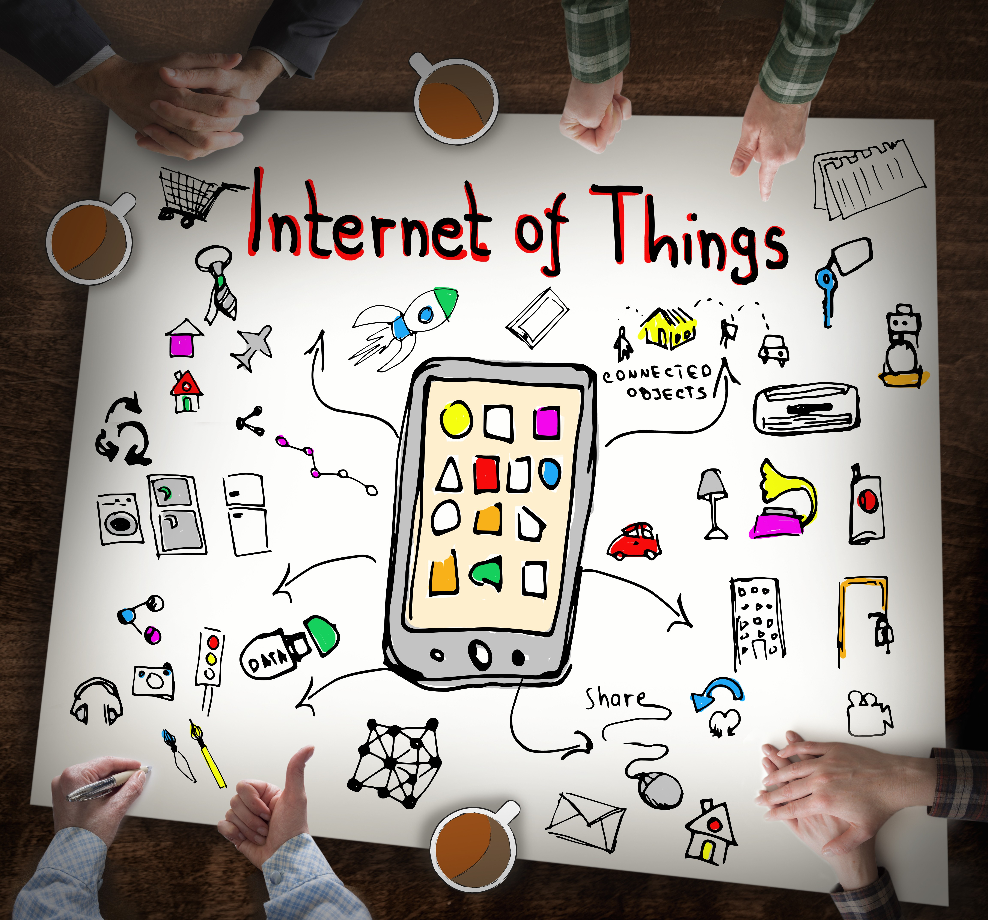
AGENDA
Brief About IoT
End to End brief architecture of IoT
IoT – Backbone of Data Analytics
Industry Use Case
Brief about Pre-Sales Role in IT Industry

Slide 3
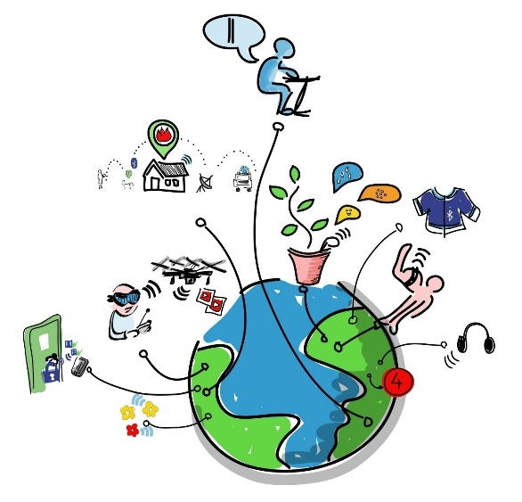
What is IoT (Internet of Things)
Internet of Things (IoT) is an ecosystem of connected physical objects that are accessible through the internet
The ‘thing’ in IoT -
a person with a heart monitor or an automobile with built-in-sensors,
i.e. objects that have been assigned an IP address
have the ability to collect and transfer data over a network
without manual assistance or intervention
The embedded technology in the objects helps them to interact with internal states or the external environment, which in turn affects the decisions taken

Slide 4
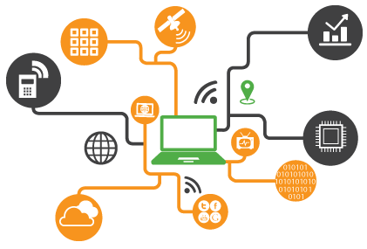
Why IoT (Internet of Things)
An article by Ashton published in the RFID Journal in 1999 said,
“If we had computers that knew everything there was to know about things - using data they gathered without any help from us - we would be able to track and count everything, and greatly reduce waste, loss and cost. We would know when things needed replacing, repairing or recalling, and whether they were fresh or past their best. We need to empower computers with their own means of gathering information, so they can see, hear and smell the world for themselves, in all its random glory.”
This is precisely what IoT platforms does for us. It enables devices/objects to observe, identify and understand a situation or the surroundings without being dependent on human help.

Slide 5
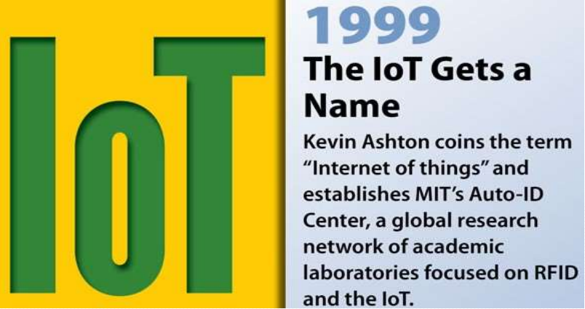

Slide 6
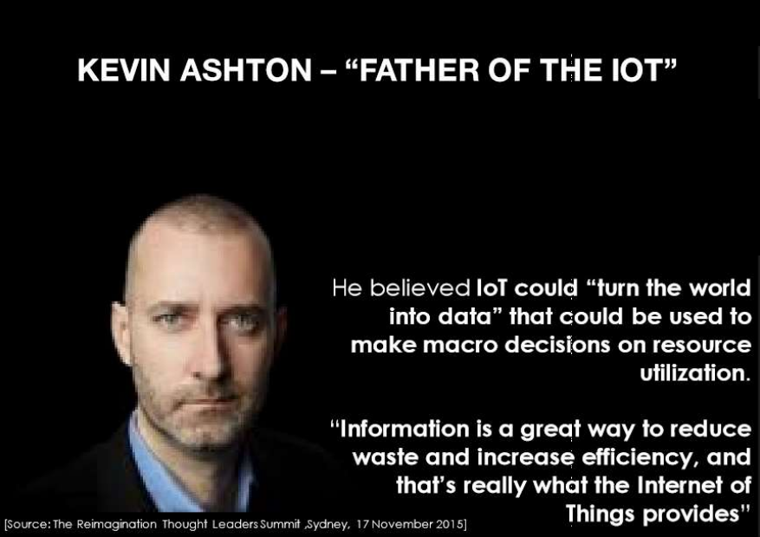
“So you get stuffs like the smart wine bottle, the smart knife, and the smart water bottle. This stuff is not the Internet of Things- this stuff is all rubbish”

Slide 7


























END-TO-END IOT SERVICE PROVIDER
smart city
Network
Platform
smart transport
smart automotive
Device Provider
Network Provider
Platform Provider
Application Provider
Customer

Slide 8
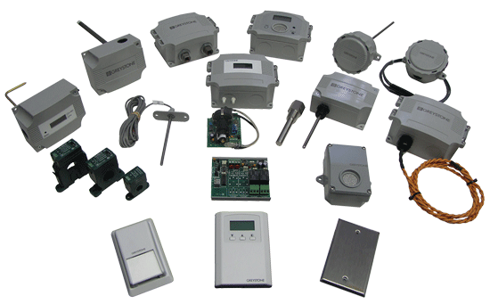



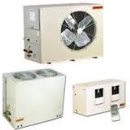
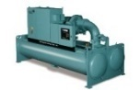




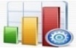

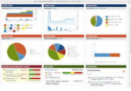
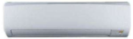

IoT Logical Architecture
Devices | Device Connectivity | Storage | Analytics | Web App | User Interface/ Reports
 | Ethernet & Wi Fi | SQL Database | Predictive analytics | Web Application | Windows App/Website
 | Other Connectors | No SQL Database | Real time Analytics | User Interface | Analytical Dashboard
 |  |  |  | Platform Components integration | Dashboard/ Reports
 |  |  |  | APIs
 |  |  |  | Relational Database
Ethernet,
WIFI and
other connectors
Hadoop, Cloud, Relational Database (SQL/Oracle) and No SQL DB(Mongo DB, Cassandra)
Machine Learning Algorithm, Python, R, Big Data Analytics
System,
Sensors/Devices
Configuration
Restful Web Service, NodeJs/AngularJs, D3Js, Plotly, R, Python libraries
IoT Components
Java, J2EE, Restful Web Service, NodeJs/AngularJs, Jboss/Tomcat, MySql
Execution Environment

Slide 9
THE INTERNET OF THINGS LIFECYCLE
COLLECT
COMMUNICATE
ANALYZE
ACT
Notes:
Analyze is where data analytics comes in picture. But in the current scenario, the challenge in not just analytics… but what to collect for analytics..

Slide 10
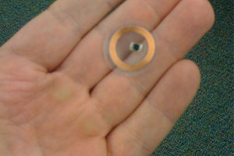
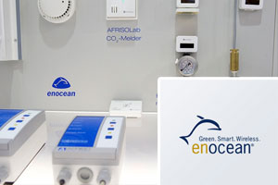
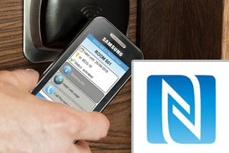
COLLECTION
Devices and Sensors are collecting data everywhere – Embedded Systems
At your home
In your car
At your office
In the manufacturing plant
Other DIY Hardware
Wireless SoC (system on chip)
Smart Dust
Operating Systems
RIOT OS
Thingsquare Mist
RFID tags
EnOcean technology
NFC
Notes:
A radio-frequency identification system uses tags, or labels attached to the objects to be identified. Two-way radio transmitter-receivers called interrogators or readers send a signal to the tag and read its response. The readers generally transmit their observations to a computer system running RFID software or RFID middleware. RFID tags can be either passive, active or battery assisted passive. An active tag has an on-board battery and periodically transmits its ID signal. A battery assisted passive (BAP) has a small battery on board and is activated when in the presence of a RFID reader.“
The EnOcean technology is an energy harvesting wireless technology used primarily in building automation systems; but is also applied to other applications in industry, transportation, logistics and smart homes. Modules based on EnOcean technology combine micro energy converters with ultra low power electronics and enable wireless communications between batteryless wireless sensors, switches, controllers and gateways.“
"NFC is a set of short-range wireless technologies, typically requiring a distance of 10 cm or less. NFC operates at 13.56 MHz on ISO/IEC 18000-3 air interface and at rates ranging from 106 kbit/s to 424 kbit/s. NFC- Near field Communication always involves an initiator and a target; the initiator actively generates an RF field that can power a passive target. This enables NFC targets to take very simple form factors such as tags, stickers, key fobs, or cards that do not require batteries. NFC peer-to-peer communication is possible, provided both devices are powered"

Slide 11
COMMUNICATION
Sending data and events through networks to some destination
A cloud platform
Private data center
Home Network
IoT Protocols
Data Broker/Cloud Service
Constrained Application Protocol (CoAP)
RESTfull HTTP
Message Queue Telemetry Transport(MQTT)
The Extensible Messaging and Presence Protocol (XMPP)
AWS IoT Cloud
MS Azure IoT Suite
ThingWorx
EVRYTHNG
GE Predix
Google Cloud IoT
IBM Watson IoT
Salesforce IoT
Can be any other On Premise Cloud
IoT Platform Comparison: https://www.postscapes.com/internet-of-things-platforms/
Notes:
"Constrained Application Protocol (CoAP) is a software protocol intended to be used in very simple electronics devices that allows them to communicate interactively over the Internet. It is particularly targeted for small low power sensors, switches, valves and similar components that need to be controlled or supervised remotely, through standard Internet networks. CoAP is an application layer protocol that is intended for use in resource-constrained internet devices, such as WSN nodes. CoAP is designed to easily translate to HTTP for simplified integration with the web, while also meeting specialized requirements such as multicast support, very low overhead, and simplicity"RESTful HTTPDescription: "Representational State Transfer (REST) is a style of software architecture for distributed systems such as the World Wide Web. REST has emerged as a predominant web API design model. "MQTT Homepage
(OASIS Page)
Description: "Message Queue Telemetry Transport (MQTT) is an open message protocol for M2M communications that enables the transfer of telemetry-style data in the form of messages from pervasive devices, along high latency or constrained networks, to a server or small message broker."XMPP Foundation
IETF WG
Description: "The Extensible Messaging and Presence Protocol (XMPP) is an open technology for real-time communication, which powers a wide range of applications including instant messaging, presence, multi-party chat, voice and video calls, collaboration, lightweight middleware, content syndication, and generalized routing of XML data.“

Slide 12
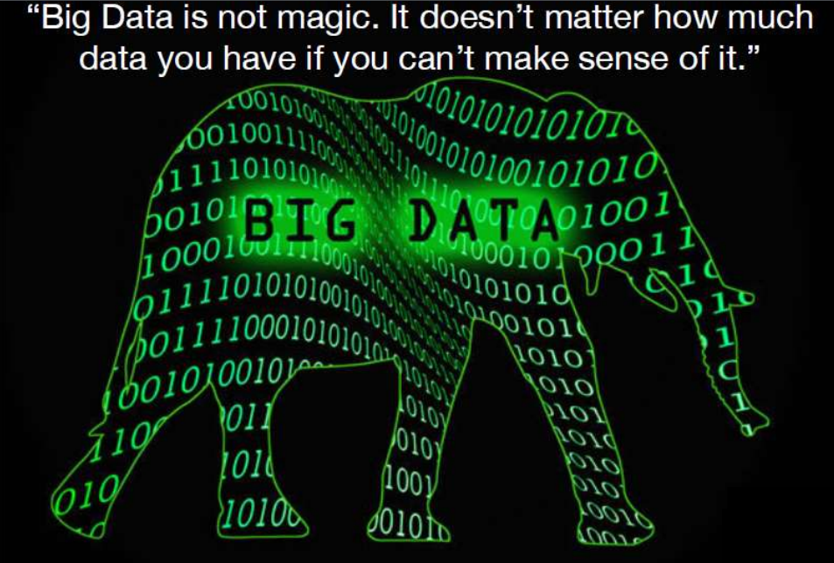
Notes:
What is Big data?
Big data is often characterized by 3Vs: the extreme volume of data, the wide variety of data types and the velocity at which the data must be processed.

Slide 13
ANALYSIS
Creating information and knowledge out of data – The Analytics
Exploratory Data Analysis(EDA)
Visualization of Data – Condition Monitoring
Building Reports
Predictive Modelling/Predictive Maintenance of Industrial data
Real time/ Near Real time Analytics
Anomaly detection
Prescriptive Analytics etc.

Slide 14
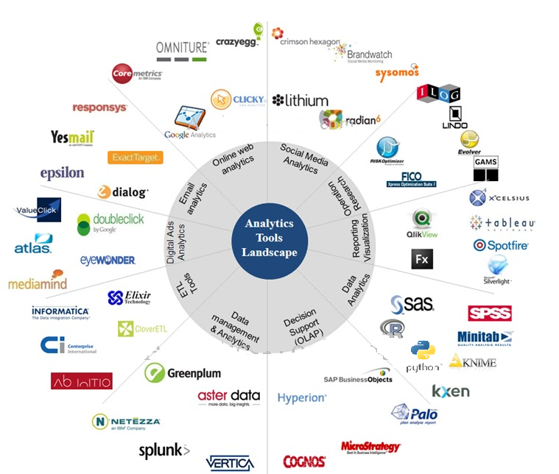
IoT
Machine Learning
(Supervised/Unsupervised)
Time Series Forecasting
Predictive Maintenance
Anomaly Detection
Condition Monitoring
Amazon ML, Azure ML, Google Prediction API, IBM Watson

Slide 15
Analytics Engine Reference Architecture – High Level
Data Source
Data Analytics Engine
Visualization & Insights
Data
Integration
Data
Preparation
Analytical Model Building & Validation
Model
Deployment
Data Storage
Dashboard
IOT Data
Data Ingestion
Missing Value Analysis
Data Preparation- Train & Test set
Batch
Processing
Reports (pdf/png)
On premise/ cloud
Extract- Stage
Deploy model in suitable environment
Outlier Treatment
Apply ML Algorithm
Data Quality
Alerts/ Notification
Other sources
Data Transformation
Evaluate Model
Data Transformation & Load
Graphs
Distributed System like Hadoop Ecosystem
R/Python
R/Python/Java

Slide 16
ACTION
Taking action based on information and data
Communicate with other machine(m2m)
Send a notification(SMS, Email, text)
Talk to another system
Remote maintainace
Any other action based(Feedback to marketing/production/research)

Slide 17
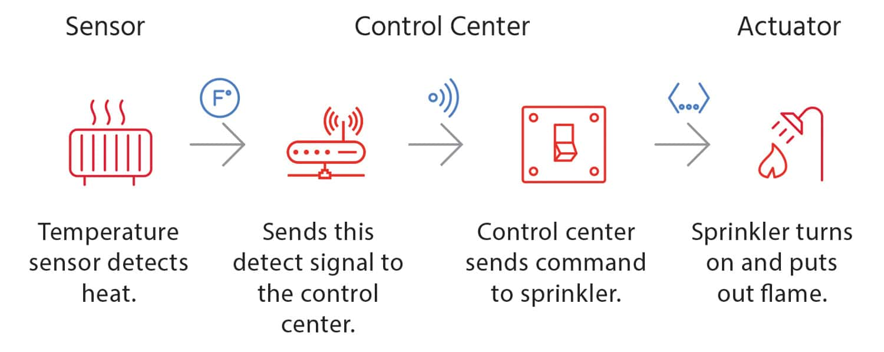
A SIMPLE IoT SYSTEM

Slide 18
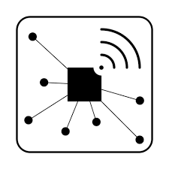

















Analytics Reference Architecture
Data Sources
Real-time Analytical Processing
Information Access
Actionable Insight
Enhanced Diverse Applications
Multi-Channel
Delivery
New Data Sources
Data Integration
Predictive Analytics
Real-Time Insights
Decision Management
Machine
& Sensor
Delivery & Visualization
Rules Management
Real Time Decision Management
Analytical Sources
New Business Model
Desktop
Image
& video
Data Integration
Data Services
Reporting, Analysis &
Content Analytics
Big Data - Hadoop
Data Publish
Business
Performance
Laptop
Enterprise
Data
Data Ingestion
Landzone
Exploration
Planning & Forecasting
Scorecards,
Dashboards
Extract - Stage
Archive
Indexing
Semantic Layer
Data Access
Budgeting
Query &
Analysis
Mobile
Web &
Social
Risk
Assessment
Data Quality
Reporting
Storytelling
Data Acquisition and Application Access
Data Warehousing
Data Caching
Collaboration
Alerting,
Monitoring
Tablet
Internet of Things
Data Transformation
Data
Warehouse
In-memory Analytics
Operations
and Fraud
Data Delivery
Discovery & Exploration
Email
Traditional Data Sources
Data Load
Data Marts
Analytical appliances
Annotation
Search
Data Virtualization
Global
Economics
SMS
Transactional systems
ODS
Cubes
Predictive Analytics & Modeling
Data Federation
Predictive Analytics
Text Analytics
Enterprise application system
Shared Operational Information
Governance
Print
Master & Reference
Content Hub
Activity Hub
Metadata
Data Link
Simulation
Optimization
External system
Data Mining
Correlations
Governance Corporate Governance Information Governance
Data Security and Business Continuity Management
Platforms Private Clouds Public Clouds On-premises HW Solutions
Notes:
Some of the Use cases :
Big Data Exploration
Enhanced 360 degree View of the Customer
Security/Intelligence Extension
Operations Analysis
Data Warehouse Augmentation
1) Sources
2) Information management-MDM,DI,Data repositories
3) Analytics-BI,Adv Analytics
4) Access
Our Consulting Engagements would result in a faster outcome
which would help the CIOs and the Engagement team begin formulating
(1) a vision towards best ways of harnessing Big Data ecosystem in their enterprises
(2) coming up with practical plans to navigate the transition by Identifying the key use cases during the Discovery phase.
In order to fully realize the benefits of SQL capabilities inside Hadoop, enterprises must first commit to
Hadoop as the foundation of their data infrastructure.

Slide 19
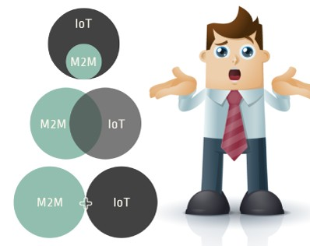
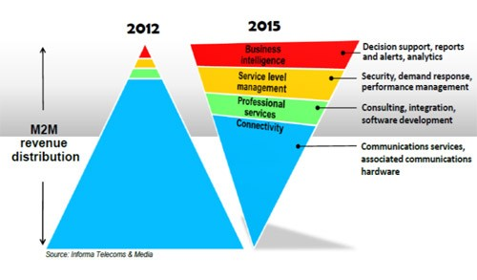
THE CURRENT ERA OF IOT
HOW IS IT DIFFERENT FROM M2M?

Slide 20
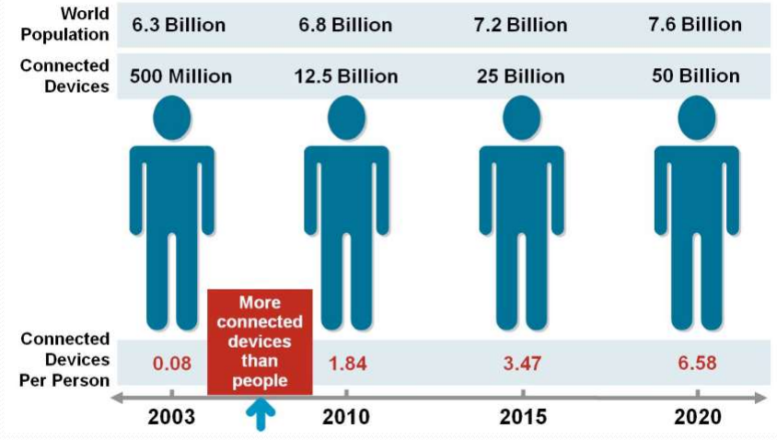
FUTURE PROSPECTS OF IoT

Slide 21
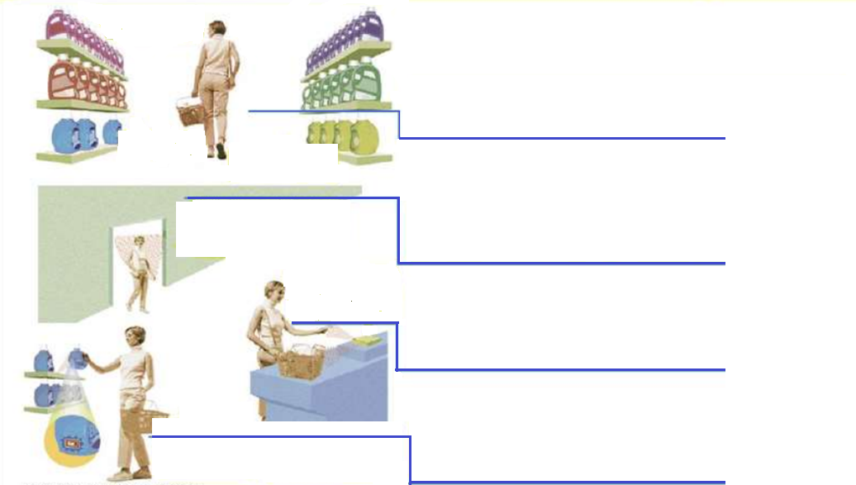
IoT Application Scenario – POS Shopping
Hi!! You could get me for less 20%
(2) When shopping in the market, the goods will introduce themselves
We are missing a bottle here. Bottler come replace it
I am a new detergent which arrived yesterday and I am very handy for washing woolen
As the shopper enters the store, scanners identify her clothing by the tags embedded in the clothes. The store knows from where she had last bought and which size she is wearing
(1) When entering the doors, scanner will identify the tags on her clothing
A microchip embedded in the credit card talks to the checkout reader and authorizes payment
(4) When paying for the goods, the microchip of the credit card will communicate with the checkout reader
As she removes a bottle of detergent, the reader in the self recognizes the need to restock and alerts the staff
(3) When moving the good, the reader will tell the staff to put a new one

Slide 22
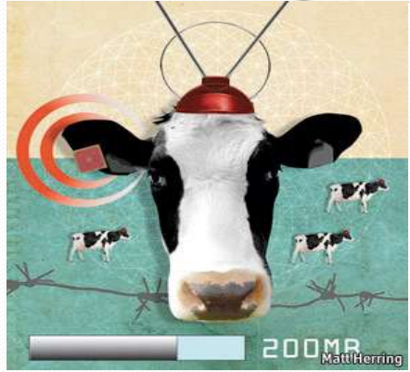
SENSORS EVEN IN HOLY COW !
Sensors are implanted in the ears of cattle which allows farmers to monitor cows’ health and track their movements, ensuring a healthier, more plentiful supply of milk and meat for people to consume. On average, each cow generates about 200 MB of information per year.
Implemented by dairy companies in US!! India??

Slide 23










WHAT ARE THE BUSINESS CHALLENGES
Fragmented industry
Collecting the right data
Security and Privacy of data
Managing vast amounts of data
Finding the right business model

Slide 24

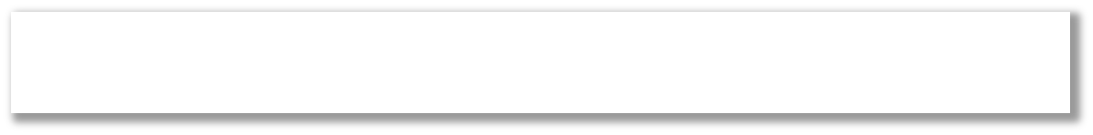



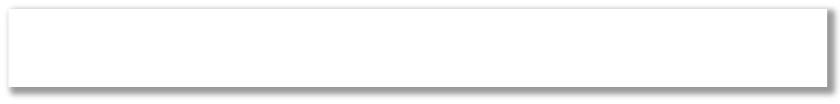
LACK OF DOMAIN EXPERTISE
THINK BEYOND CONNECTIVITY
SOLUTIONS, SELLING
AND MANAGED SERVICES
NEED GO-TO-MARKET PARTNER
Copyright © RIOT 2015 All Rights Reserved

Slide 25



TO OVERCOME 3 KEY CHALLENGES
Integrating data from multiple sources
Automating the collection of data
Analyzing data to effectively identify actionable insights
Only by addressing all three can organizations turn raw data into information and actionable insights.

Slide 26
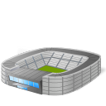






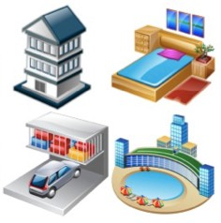



CHALLENGES – DATA OWNERSHIP
Organizations
Commercial Sensor Data Providers
Personal and Households
Private
Public
All personal items, such as mobile phones, wrist watches, spectacles, laptops, soft drinks, food items and household items, such as televisions, cameras, microwaves, washing machines, etc
Private business organization has the right to take the decision whether to publish the sensors attached to those items to the cloud or not.
Public infrastructure such as bridges, roads, parks, etc. All the sensors deployed by the government will be published in the cloud depending on government policies.
Business entities who deploy and manage sensors by themselves by keeping ownership. They earn by publishing the sensors and sensor data they own through sensor publishers.
[Source: “Sensing as a Service Model for Smart Cities Supported by Internet of Things”, Charith Perera et. al., Transactions on Emerging
Telecommunications Technology, 2014]

Slide 27
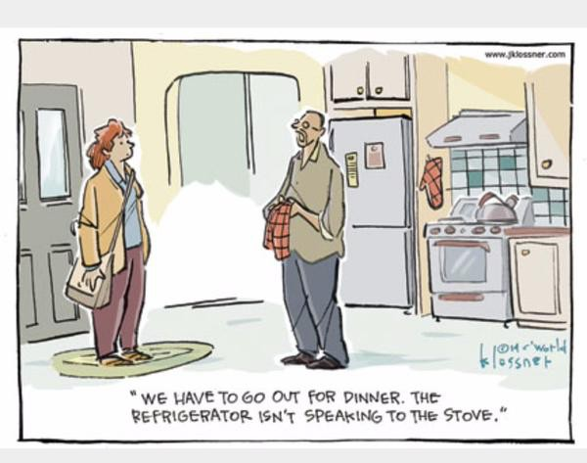
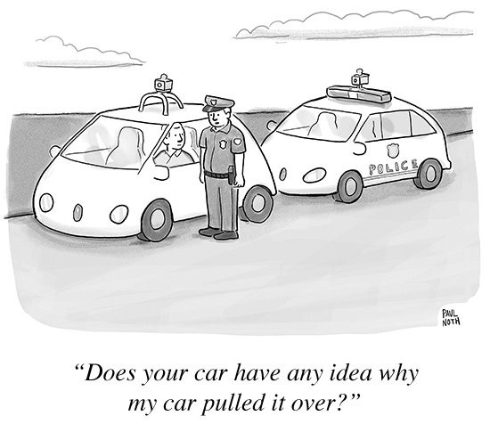

Slide 28
Below slides not to be shared

Slide 29
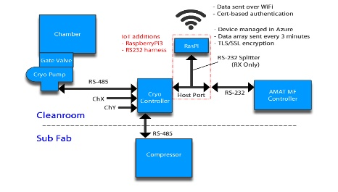
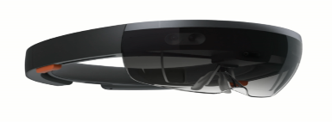
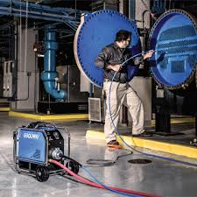
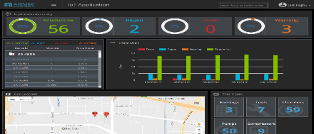
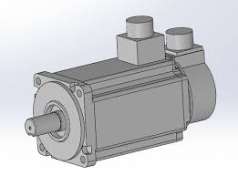
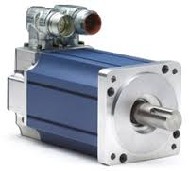
IoT ROADMAP
Augmented Reality Led Virtual Maintenance
Design and Visualize 3D model of an Asset
Visually isolate problem area of Assets
Analyze assigned service ticket/job
SOP driven remote troubleshooting
Access to interactive technical manuals
Video calling to analyze problem with on-site engineer
Predictive Maintenance
Build Integration with enterprise system (ERP, SM sys..)
Proactively schedule maintenance activity through work order automation
Prescriptive Maintenance
Use historical service records as reference points
Recommend set-of maintenance activities and tools/equipment
Predictive Analytics
Built an algorithm to identify the root causes for fault code & reduce repeated problems
Use the asset data to predict events before they happen
Develop an algorithm to predict RUL for asset
Use historical service records as a data point
Build Algorithm to depict asset OEE
Condition Monitoring
Platform Build - Data Ingestion + Cleansing + Storage + Application + Portal
Monitor device in near real-time for alert and alarms
Begin to use the device KPI data to gain insights into asset performance
KPI/CPI based data baselining
IoTization of Asset
Identify and use splitter, converter, sensor & gateway
Determine Integration Protocol (D2C, C2D & Between Gateway, device & sensor)
Depicting Through Predictive Maintenance Maturity Model

Slide 30

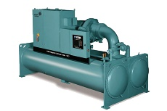
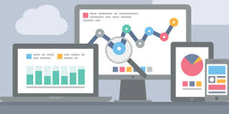

Case Study : Definition - Compressor Failure Prediction
Category | Commercial (VRF / PAC)
Geography | Europe
Use Case Description
HVAC systems plays a critical role in commercial properties and need to satisfy high availability requirements. Unexpected failure of compressor needs to be monitored to predict and avoid any interruption in operation. Providing an analytical solution to predict compressor failures and raising an early alarm will help in seamless operation.
Notification with
all parameters predicting Stop condition
(Offline)
Verify contract
Validate Warranty
Corrective Action
Alerts sent to Service Engineer
Based on predictive algorithm
Compressor
Failure Prediction
Data Available in cloud
Compressor
Service Team
Preventive / Corrective
In-person
Service Portal
Data Available
Data Gap
Benefits of Use-case to HVAC Customer
Discharge gas temp, Impulses of the expansion valve, Pressure of discharge gas, Frequency of compressor, Operation mode, Ambient, Evaporation Temperature, Error Code..
Failure Data
Type of Failures
Frequency, Root Cause of Failures
Proactive intervention to reduce downtime
Reduction in costs due to downtime repairs & services
Continuous User Comfort

Slide 31


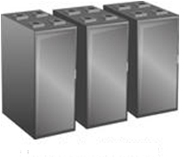

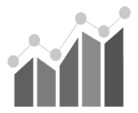

Case Study : Proposed Implementation Approach for Compressor Failure Prediction
Cloud
1
2
3
Model
Validation
Data Preparation
Pre-Processing
Model
Building
4
Prepare data by
Extracting all the operating parameters information before 5 or 10 minutes prior to compress stop – This provides information related to failure cases
Prepare data of non-failure cases from the existing data
Combine both failure and non failure cases
It will create a data set required for the model building.
Data validation
Missing value Analysis
Outlier Analysis
Data Transformation
Prepare Train and Test data using Stratified Random Sampling, so that failure and non-failure cases will have equal representation in train and test data.
Build supervised ML model using XGBoost, SVM, Logistic Regression on train data
Tune the model parameters for optimal prediction power
Evaluate the model accuracy on test data
Compressor
Model
Deployment
5
Deploy the model through PMML or any alternative approach to predict the failure cases and to raise early alarm of compressor failure
6
Visualization
4
Evaluate the model performance at regular intervals through various statistical techniques and Re-Fit or Re-Build the model accordingly.

Slide 32
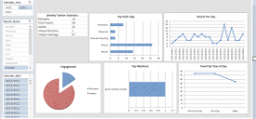



USE CASE : Anomaly Detection – Rule Engine data driven Asset Predictive Model
Building Rule Engine (Data driven), Predictive model and IoT dashboards.
Business user (non-turbine expert) can drive the Anomaly detection process.
This generic model can be reused to know the economic or safety conditions of similar Assets.
Meteorological data
Legacy system data
3rd party
Incident Management
Blogs
In house tools
Preventive Maintenance
Forums
O&M
Data
Anomaly Dashboard
Trend Scorecard
Ingest
10-minute
averages
of the
sensor values
Sensor Data
(time series)
SCADA Monitoring system
Actual value
Compare
Analysis Asset- Sensor behavior
Residual
Sensor Model
Machine Learning
(driven by Rule Engine)
Data Collection
Ingesting Historical previous values
Predicted
value
Execution
Business users define Rule
Rule Set 1 : Model 1
Rule Set 2 : Model 2
…
Rule Set n : Model n
Rule Engine
Any other Asset

Slide 33














VALUE IS CREATED BY MAKING SENSE OF DATA
More Important
Wisdom
Evaluated understanding
Understanding
Appreciation of
WHY
Knowledge
HOW
Answers to
questions
Information
Answers to
WHO
WHAT
WHERE
WHEN
questions
Less Important
Data
Symbols
VALUE PYRAMID

Slide 34
PRE-SALES Role

Slide 35
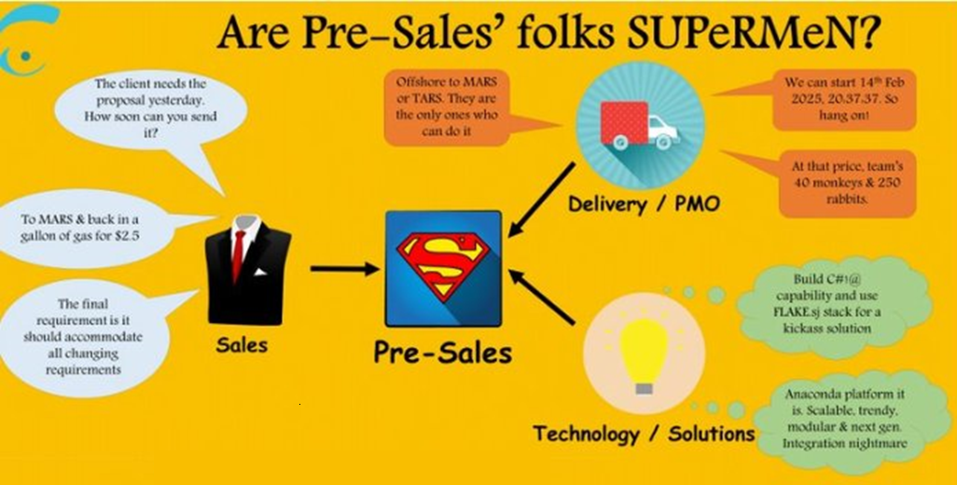

Slide 36
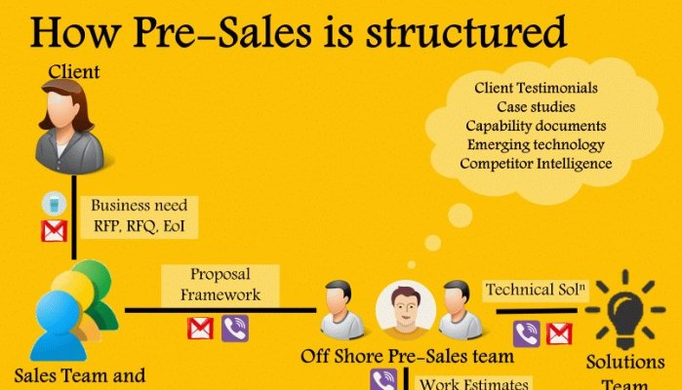

Slide 37
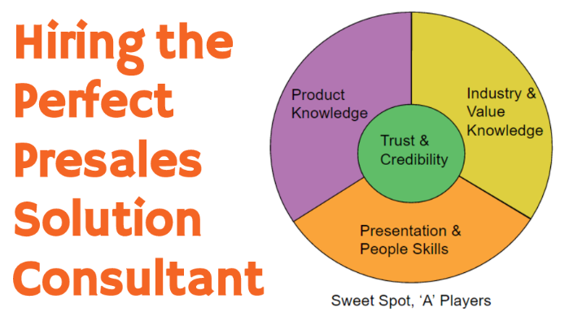

Slide 38

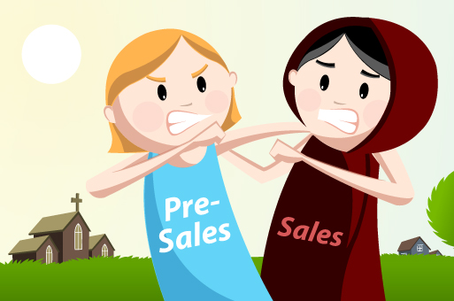
Delivery

Slide 39
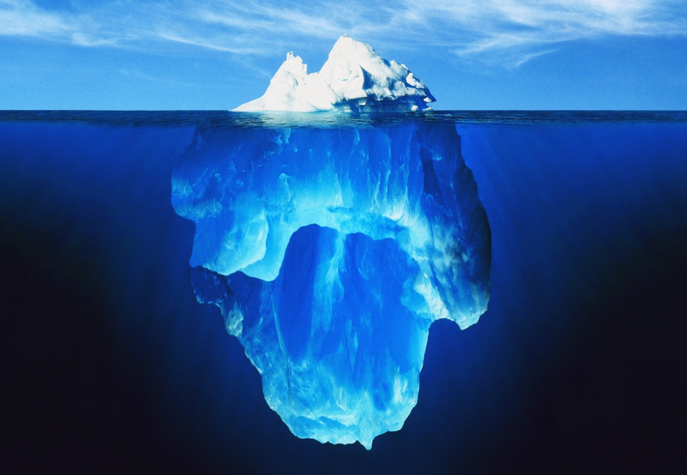
Thank You
Questions are guaranteed…. But Answers are not!!!

